Slide 1



Team Project 2 : Property Graphs
Master’s in Computer Engineering
Database 2
Marco alecci , Luca martinelli, elia ziroldo
Academic year 2021/2022

Slide 2



Data Recap
Spotify’s Monthly Top 100 charts
35 countries from 2017-2020
Data enriched using WikiData and MusicBrainz APIs

Slide 3



Additional Data
Record Labels which have contracts with artists
Instruments played by artists
Gender of the artists

Slide 4
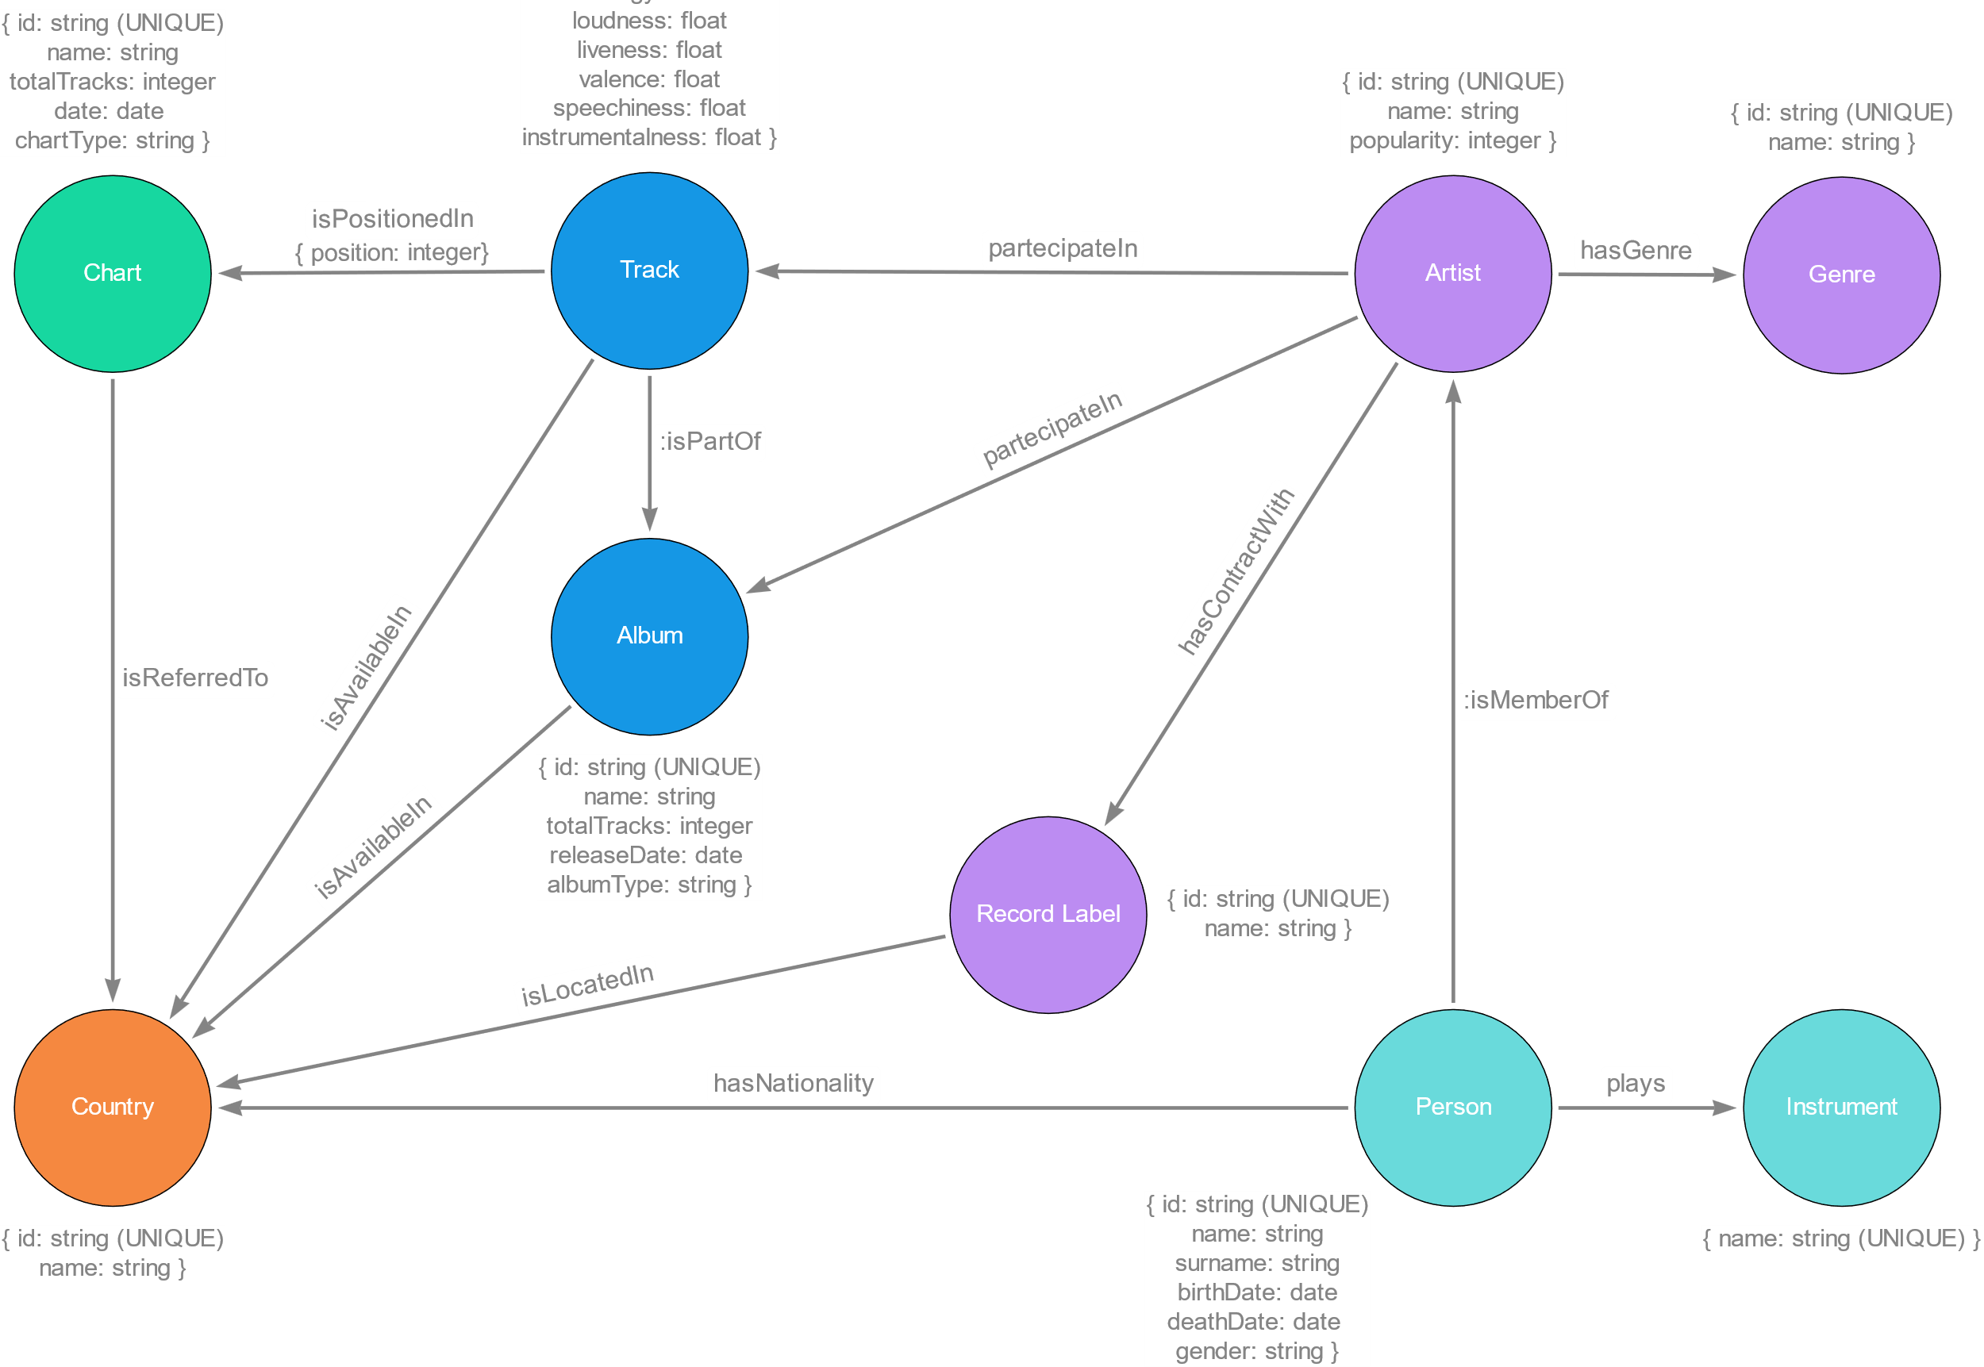
Model

Slide 5
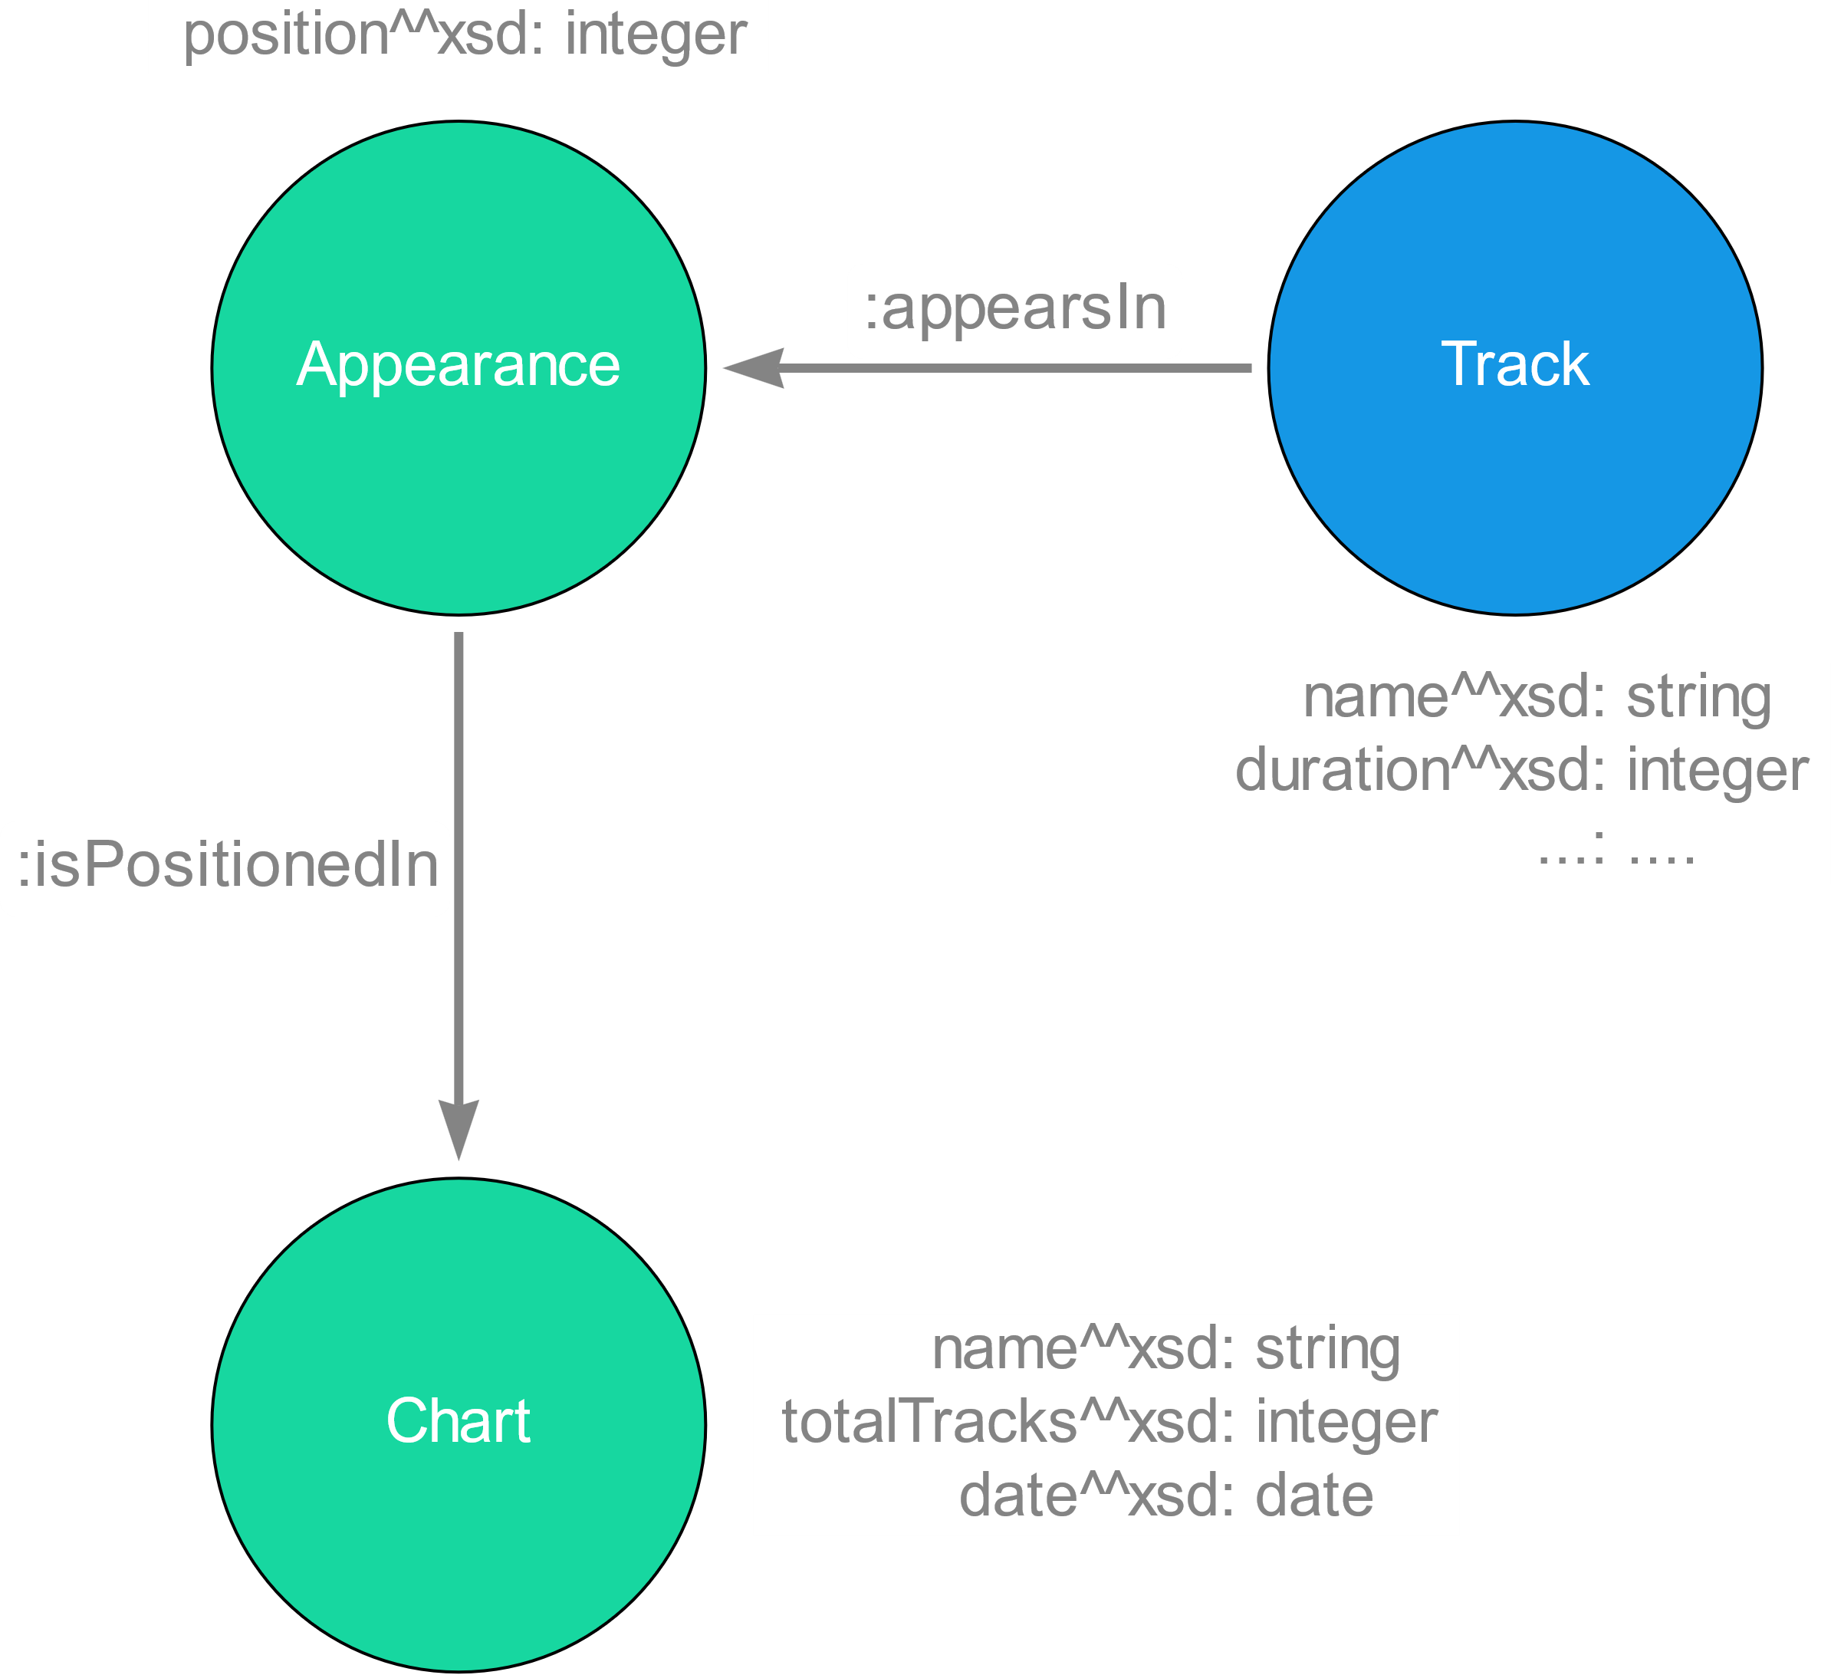
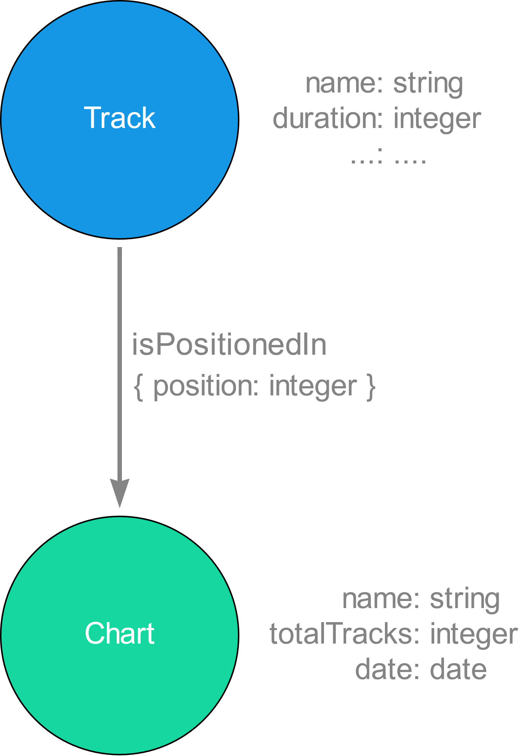
Model : Focus 1
RDF
Property Graphs

Slide 6
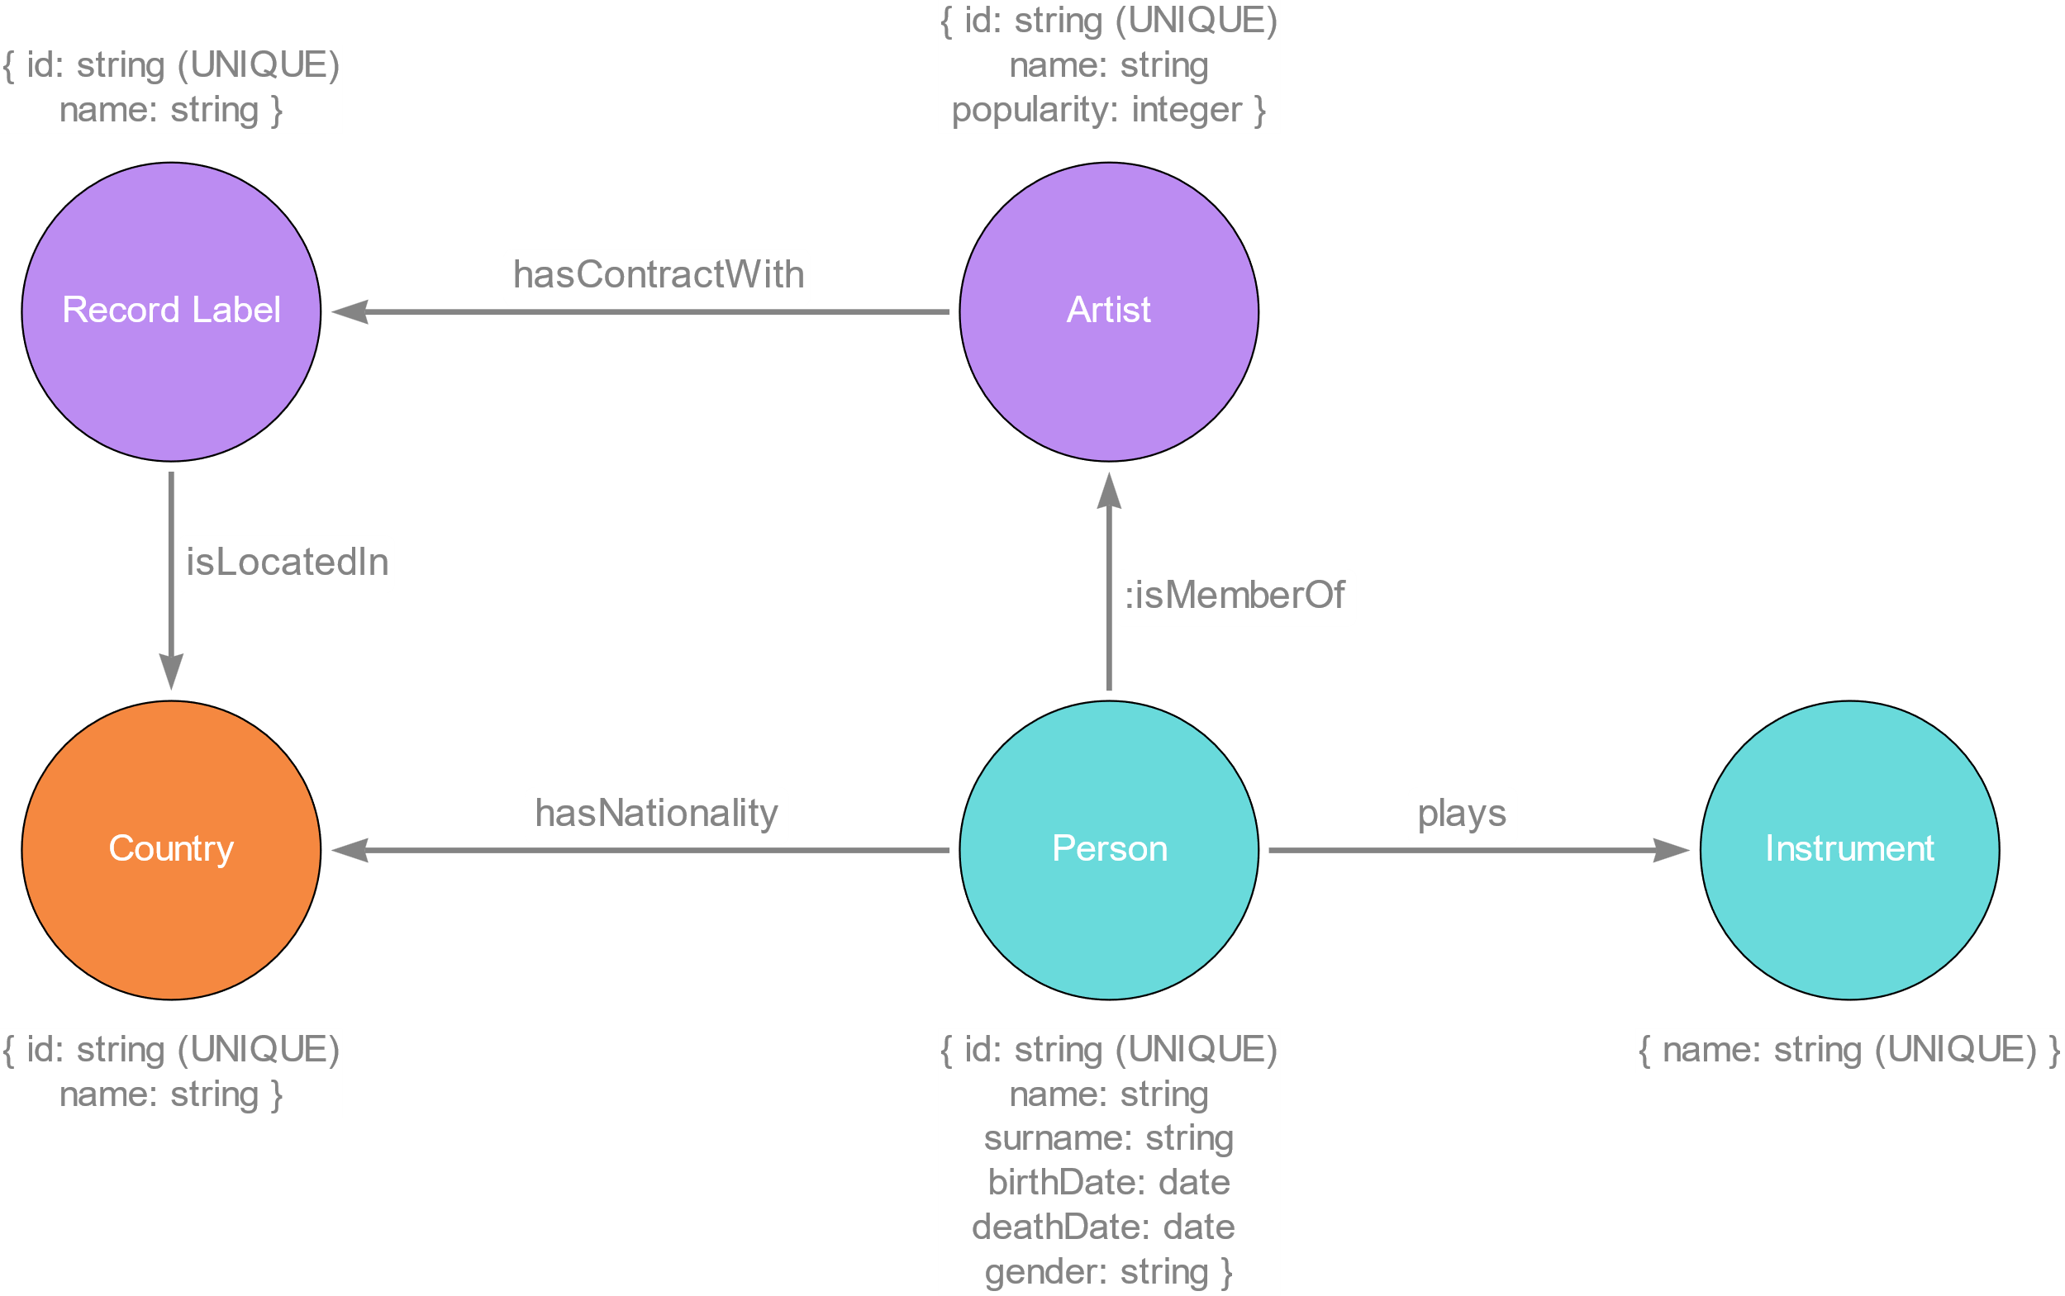
Model : Focus 2

Slide 7
Ingestion Phase

Slide 8
Ingestion Phase
MERGE
Check if already exists
CREATE
Not uniqueness check
CREATE +
UNIQUE CONSTRAINTS
Indexes created for the IDs
LOAD_CSV
with customized CSV files
Less control, but faster

Slide 9
Ingestion Phase Analysis
Tested with Intel i5 5200U CPU @ 2.20GHz, 2195 Mhz and 8GB of RAM
Method | Genres | Countries | Artists | Albums | Tracks | Charts | People
MERGE | 16s | 7s | 3m 21s | 650m | 24H+ | / | /
CREATE | 16s | 6s | 3m 01s | 516m | 24H+ | / | /
CREATE + UNIQUE CONSTRAINTS | 15s | 4s | 2m 39s | 183m | 317m | 77m | 2m 41s
LOAD_CSV | 4s | 5s | 8s | 1m5s | 4m35s | 53s | 9s

Slide 10
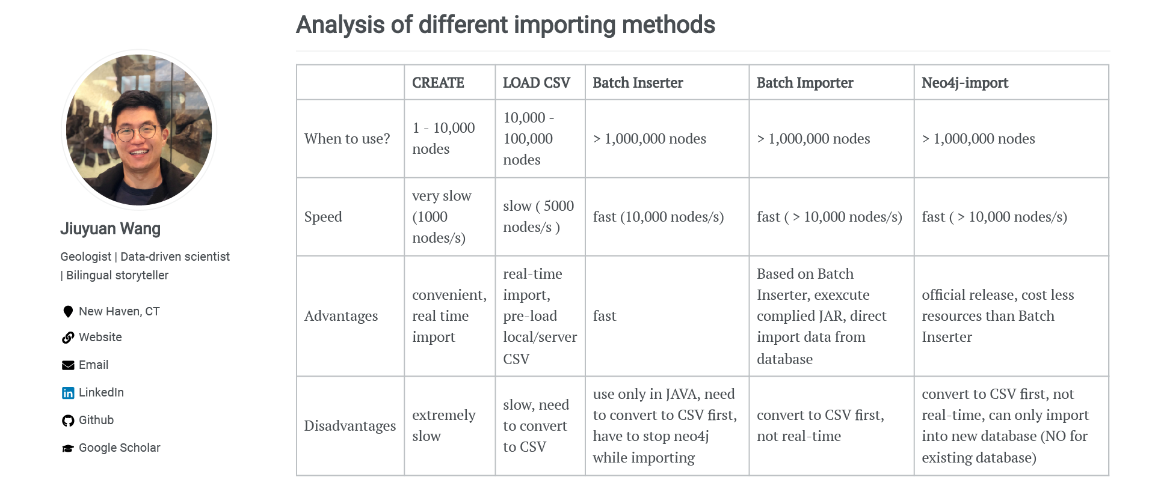
Ingestion Phase Reference
Ref: https://julianwangnwu.github.io/posts/2019/06/import-neo4j/

Slide 11
Queries

Slide 12



Queries
Example Queries
Show how it is possible to use the new added information such as record label and instruments
Italian Tracks and Italian Artists
Study Italian tracks and artists present in the TOP 100 Italy
Italian Music Abroad
Discover if Italian tracks are listened also outside Italy

Slide 13
Queries Part 1: Example Queries

Slide 14






Top 3 record labels according to the ratio: ${\begin{aligned}\text{average} \text{position} \\ \text{reached}\end{aligned}}/{\begin{aligned} \text{number} \text{of} \text{tracks} \\ \text{released}\end{aligned}}$
Average Position: 50th
Number of Tracks: 2255
Average Position: 47th
Number of Tracks: 1217
Average Position: 51st
Number of Tracks: 1186

Slide 15



Most common instruments played by members of rock groups
Guitar
159 artists
Voice
127 artists
Drum Kit
67 artists

Slide 16
Queries Part 2: Italian Tracks and Italian Artists

Slide 17
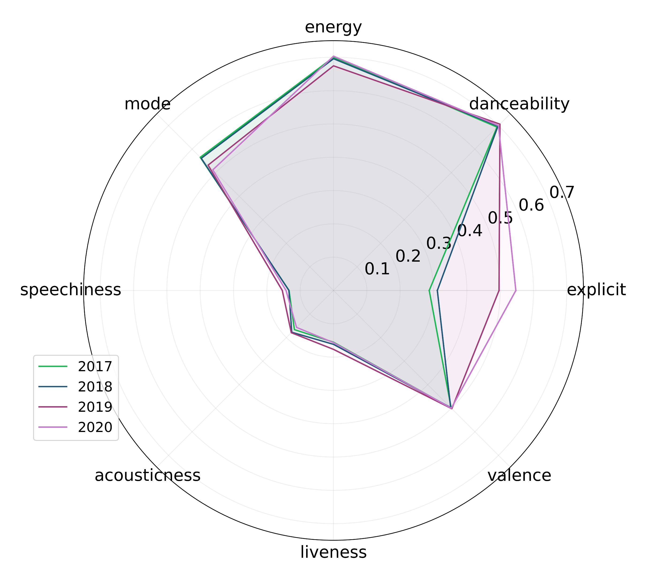
Technical features of Italian Tracks through the years 2017-2020

Slide 18
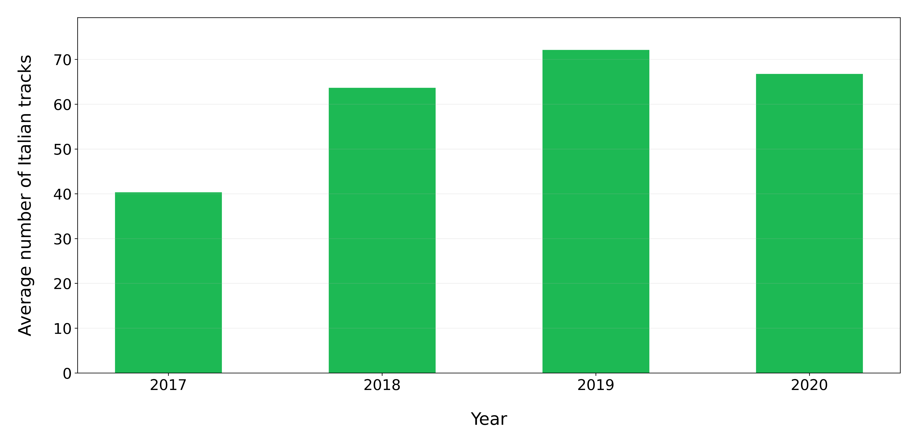
Average number of Italian tracks present in Top 100 Italy for each year

Slide 19
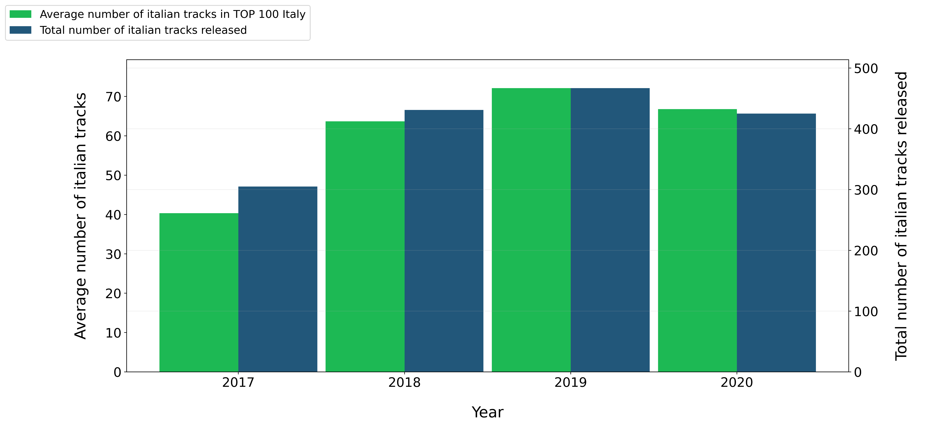
Italian tracks released every year from 2017 to 2020

Slide 20
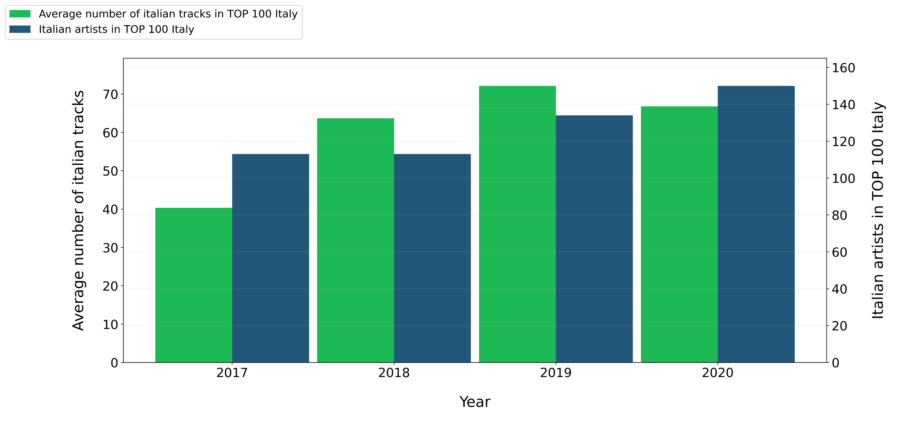
Italian artist entered in Top 100 Italy for each year

Slide 21
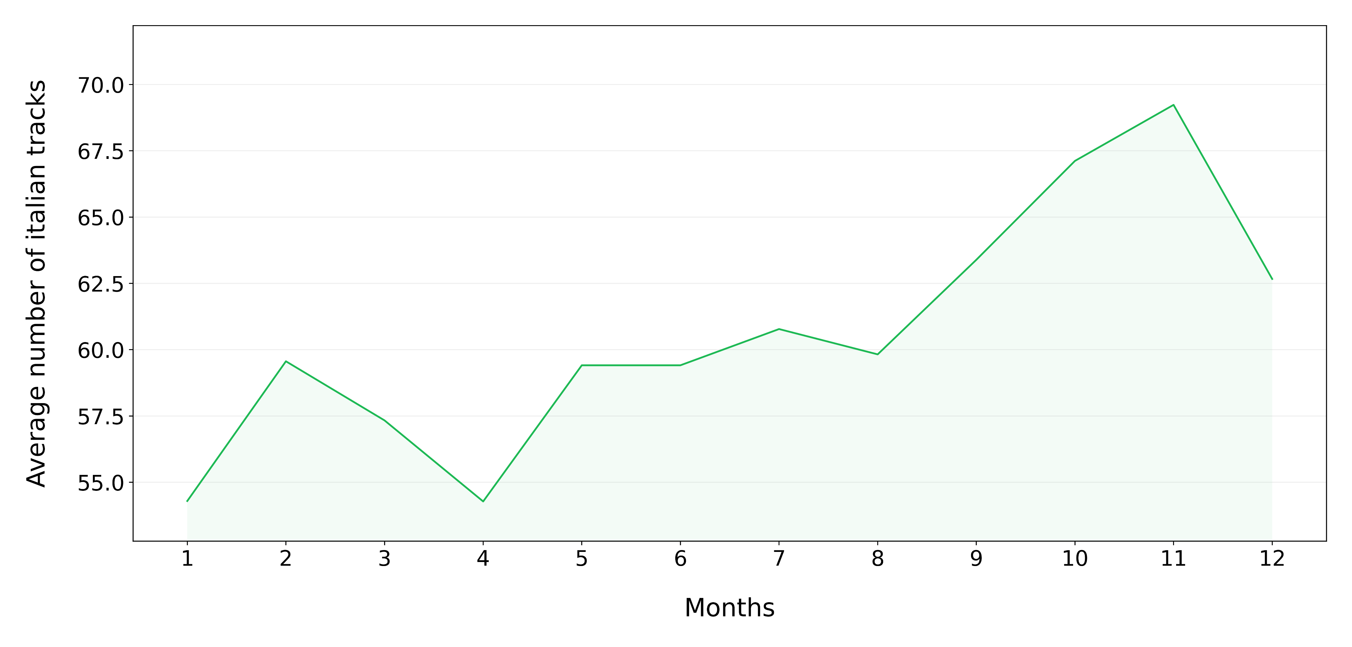
Average number of Italian tracks in Top 100 Italy through months of the year

Slide 22
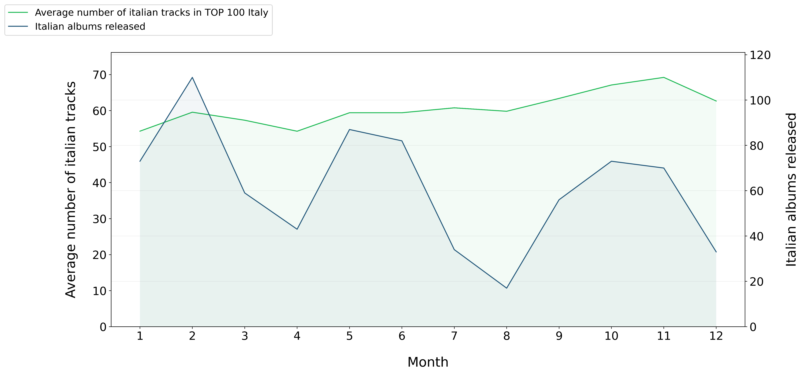
Albums from Italian artists released through the different months of the year

Slide 23
Albums from Italian artists released through the different months of the year

Slide 24




Italian artists with the highest number of tracks in Top 100 Italy for each year
2017
Guè, 30 Tracks
2018
Gemitaiz, 31 Tracks
2019
Lazza, 35 Tracks
2020
Tha Supreme, 40 Tracks

Slide 25
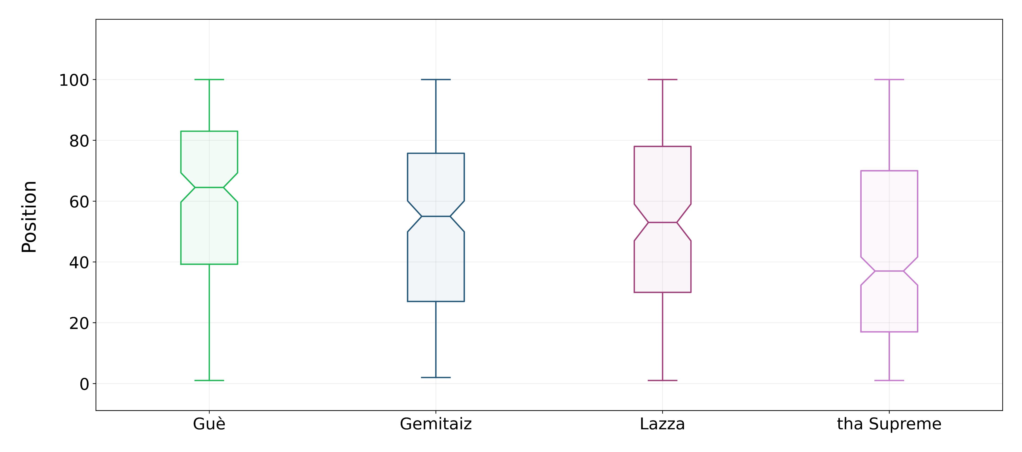
Distribution of the positions in the TOP 100 Italy reached by these artists

Slide 26


Top 3 Italian artists with the highest number of tracks in Top 100 Italy at the same time
Tha Supreme
17th Nov 2019
24 tracks
Tedua
14th June 2020
21 tracks
Marracash
17th Nov 2019
19 tracks

Slide 27



Check if these artists released an album on the same month (or previous one)
Tha Supreme
17th Nov 2019
24 tracks
Tedua
14th June 2020
21 tracks
Marracash
17th Nov 2019
19 tracks
“23 6451”
15th Nov 2019
“Vita Vera Mixtape”
5th June 2020
“Persona”
31th Oct 2019

Slide 28
Queries Part 3: Italian Music Abroad

Slide 29
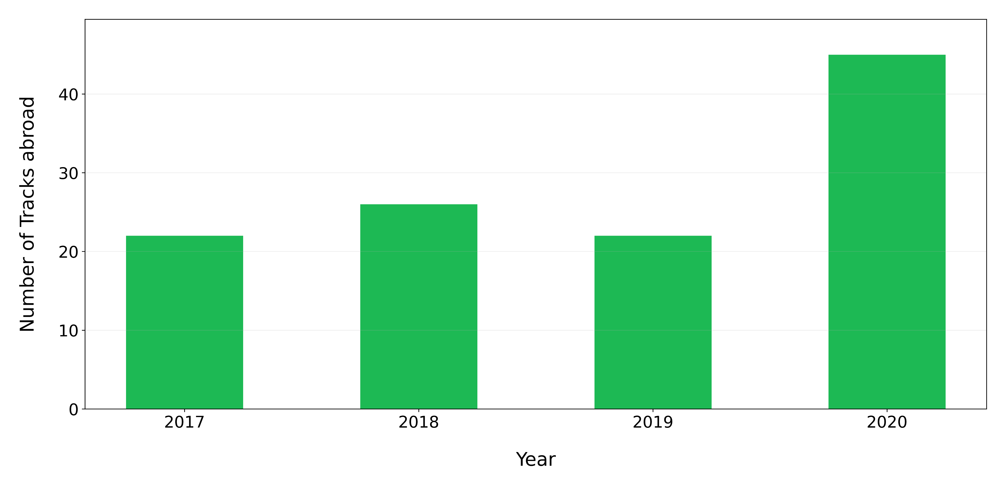
Italian tracks in a Top 100 of a country different from Italy for each year

Slide 30
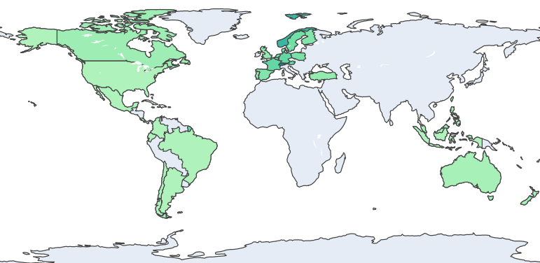
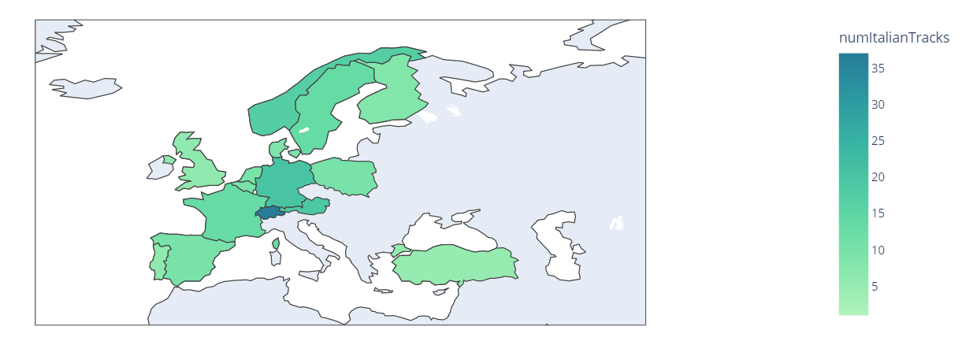
Countries that listen the most to Italian tracks

Slide 31
Countries that listen the most to Italian tracks: Europe Focus

Slide 32
How to determine the most widespread Italian artist?
1st Approach:
Count, for each artist, how many different countries he has reached excluding Italy.
2nd Approach:
Count, for each artist, how many of his tracks have entered in a TOP 100 of a country different from Italy

Slide 33


Most widespread Italian artist abroad
1st Approach:
Gigi D’Agostino
30 different countries excluding Italy
2nd Approach:
Sfera Ebbasta
12 tracks in a TOP 100 of a country different from Italy

Slide 34
References
Kaggle Spotify Dataset : https://www.kaggle.com/pepepython/spotify-huge-database-daily-charts-over-3-years?select=Database+to+calculate+popularity.csv
Spotify Web API : https://developer.spotify.com/documentation/web-api/
WikiData : https://www.wikidata.org/wiki/Wikidata:Main_Page
MusicBrainz : https://musicbrainz.org/
Neo4j Ingestion Analysis: https://julianwangnwu.github.io/posts/2019/06/import-neo4j/

Slide 35
Thank you for the attention

